Slide 1
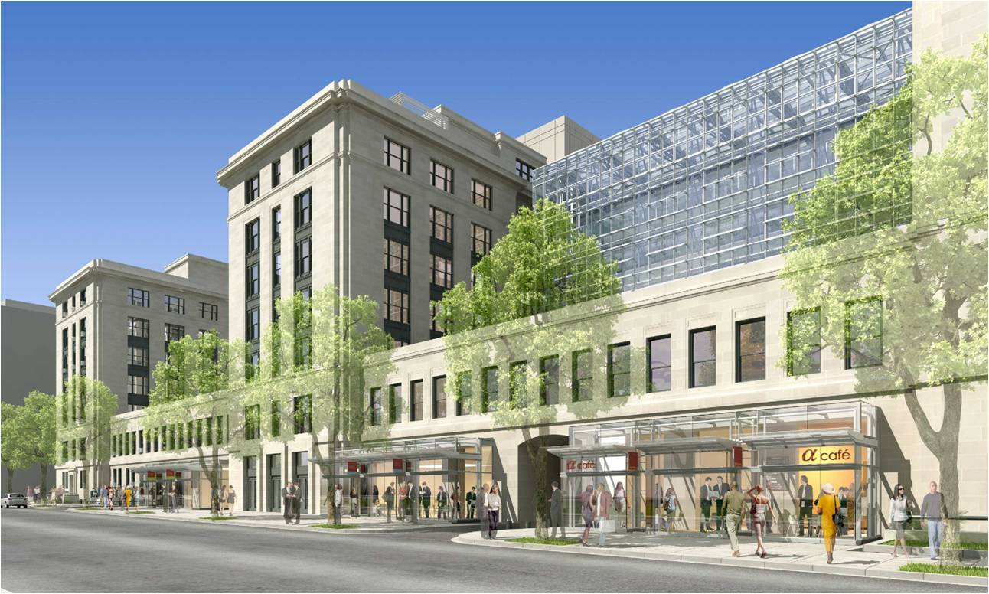
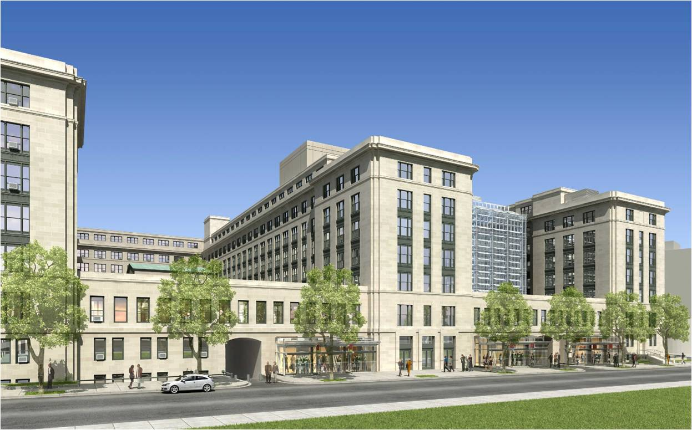
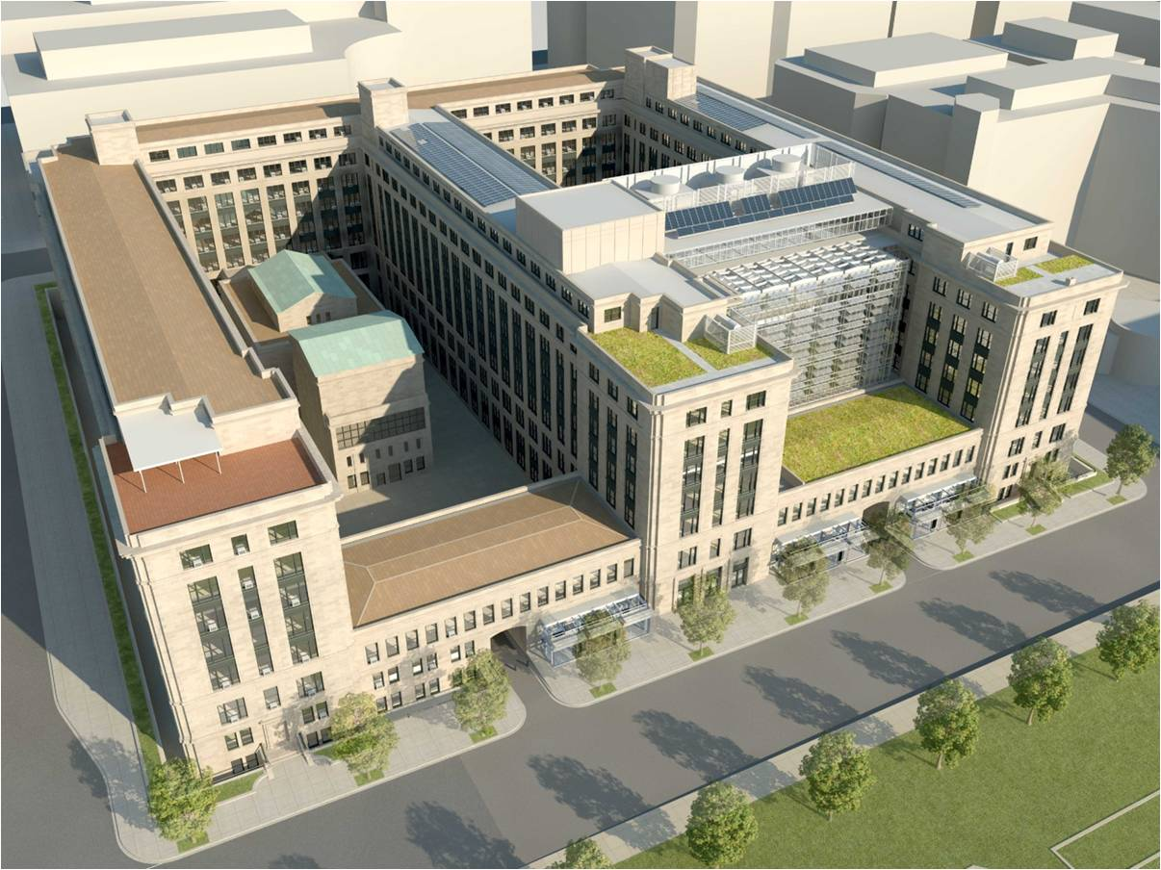
U.S. General Services Administration Headquarters Modernization – Phase 1
1800 F St. NW, Washington, D.C.
The Pennsylvania State University Architectural Engineering Capstone Project
Ramuel Holgado | Construction Management Option | Advisor: Dr. Chimay Anumba

Slide 2
Overview
Project Background
Analysis 1: New Addition Façade Redesign
Analysis 2: New Addition Foundation System
Analysis 3: 3D Laser Scanning Implementation
Analysis 4: Operation and Maintenance of Energy
Conclusion
Acknowledgements

Slide 3
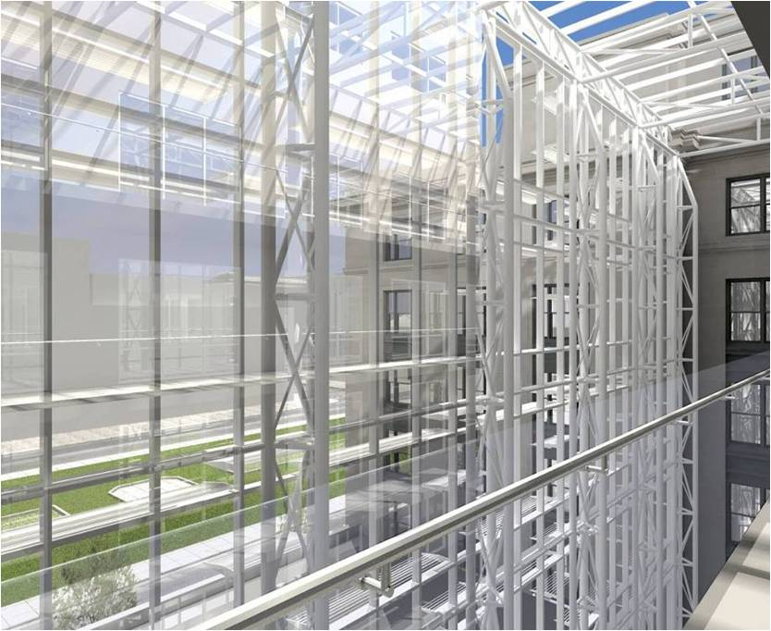
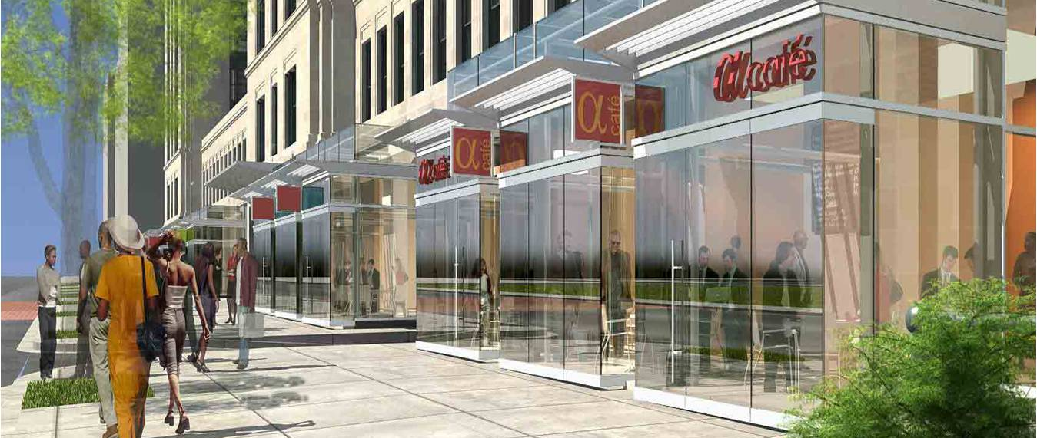
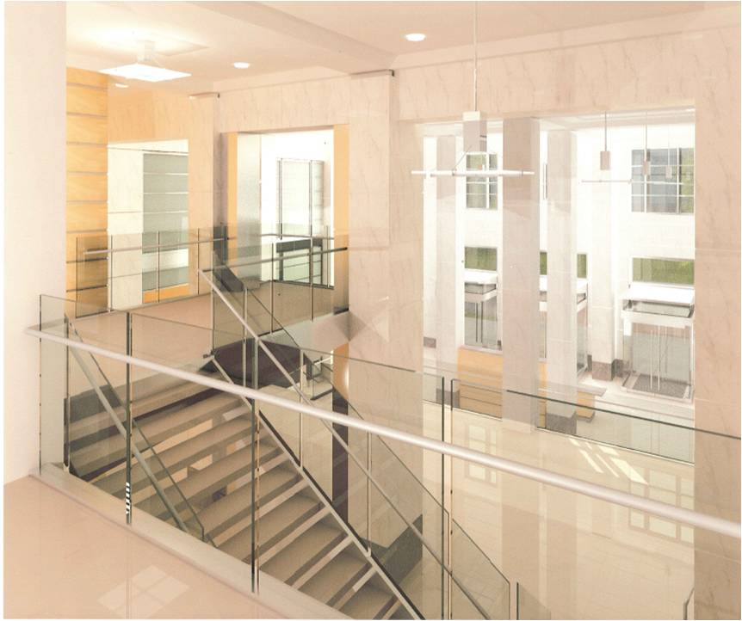
Overview
Project Participants
Building Overview – Phase 1
Project Background
Analysis 1: New Addition Façade Redesign
Analysis 2: New Addition Foundation System
Analysis 3: 3D Laser Scanning Implementation
Analysis 4: Operation and Maintenance of Energy
Conclusion
Acknowledgements
Owner: U.S. General Services Administration
General Contractor: Whiting-Turner/Walsh Joint Venture
Construction Manager: Heery International
Architects: Gensler & Shalom Baranes Associates, PC
Structural Engineer: Thornton-Tomasetti Group
MEP Engineer: Syska
Location: 1800 F St. NW, Washington, D.C.
Existing Building Size: 362,000 SF
New Addition Size: 67,000 SF
Number of Stories: 9 Stories
Project Cost: $87,069,000
Dates of Construction: September 15, 2010 – May 20, 2013
Project Delivery Method: Design-Bid-Build
Notes:
Project Participants: GSA & Whiting-Turner/Walsh Joint Venture
Building Overview – Phase 1: Location, Size, Stories, Cost, and expected to be completed next week

Slide 4
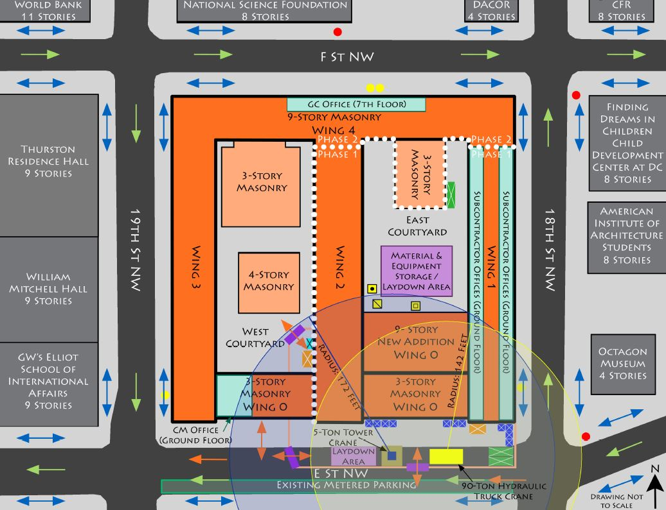
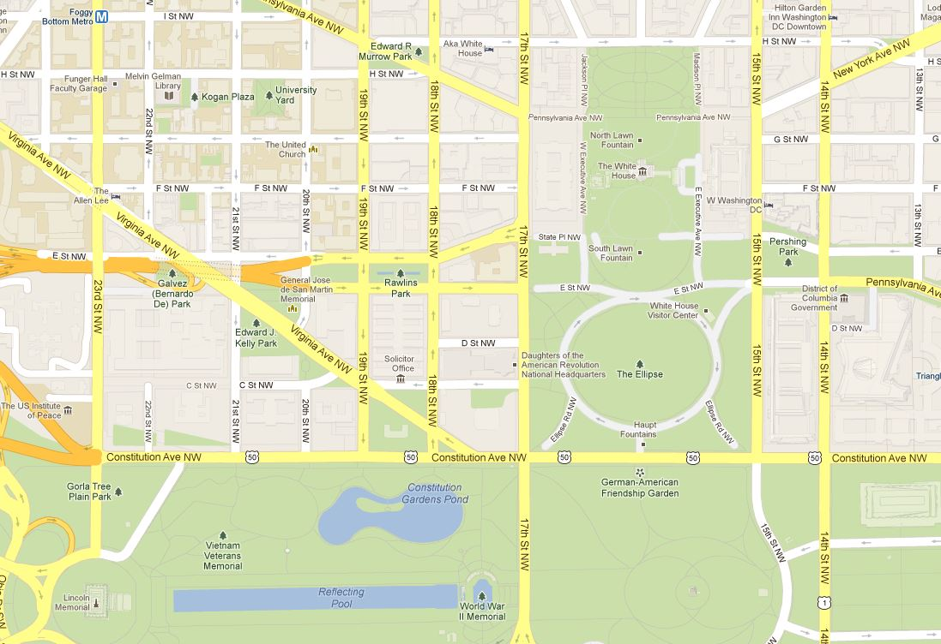
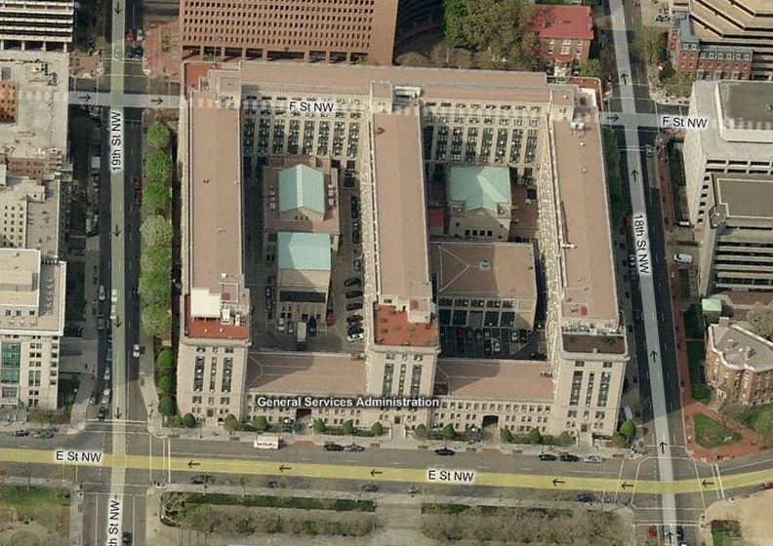
Overview
Construction Site Plan
U.S. General Services Administration Headquarters Modernization – Phase 1
1800 F St., Washington, D.C.
Ramuel Holgado | Construction Management Option
Project Background
Analysis 1: New Addition Façade Redesign
Analysis 2: New Addition Foundation System
Analysis 3: 3D Laser Scanning Implementation
Analysis 4: Operation and Maintenance of Energy
Conclusion
Acknowledgements
Courtesy of Bing Maps
Courtesy of Google Maps
Notes:
Located in downtown D.C. just a couple of blocks from the White House.
Has 4 existing wings that are 9 stories high and shaped like the letter “E”.
A 5th existing wing is 3 stories high.
Phase 1 is below and to the right of the dotted white line.
Phase 1 has a New Addition in the East Courtyard that will be 9 stories tall.

Slide 5
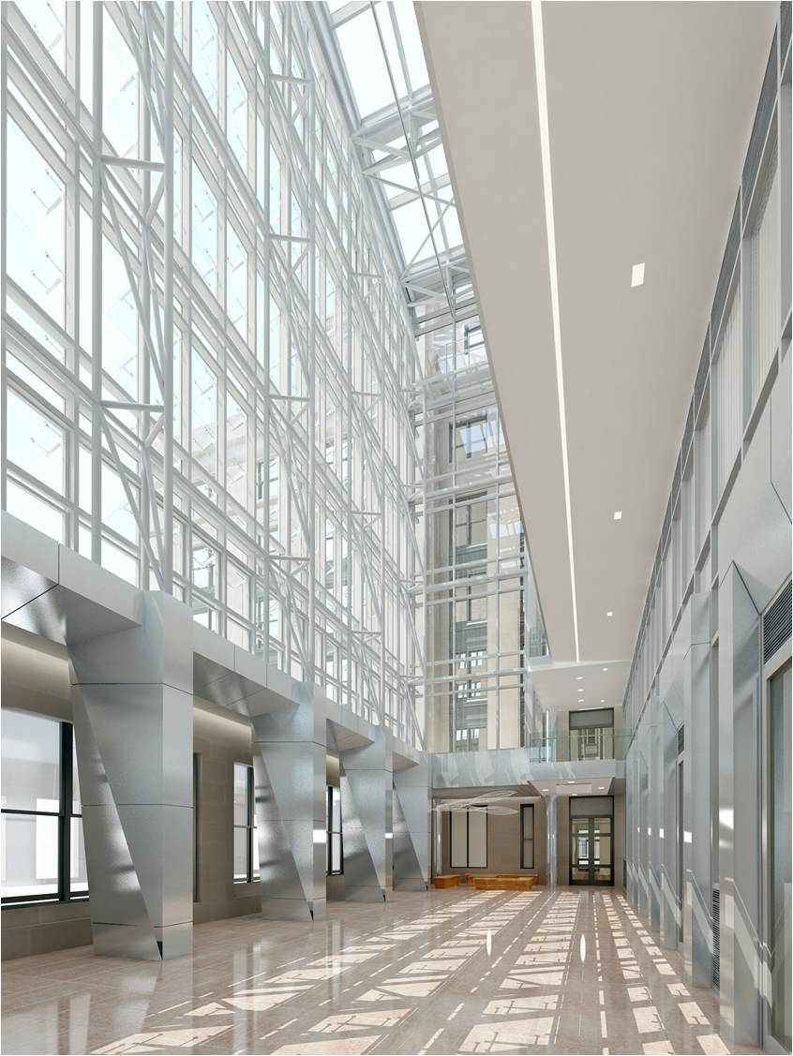
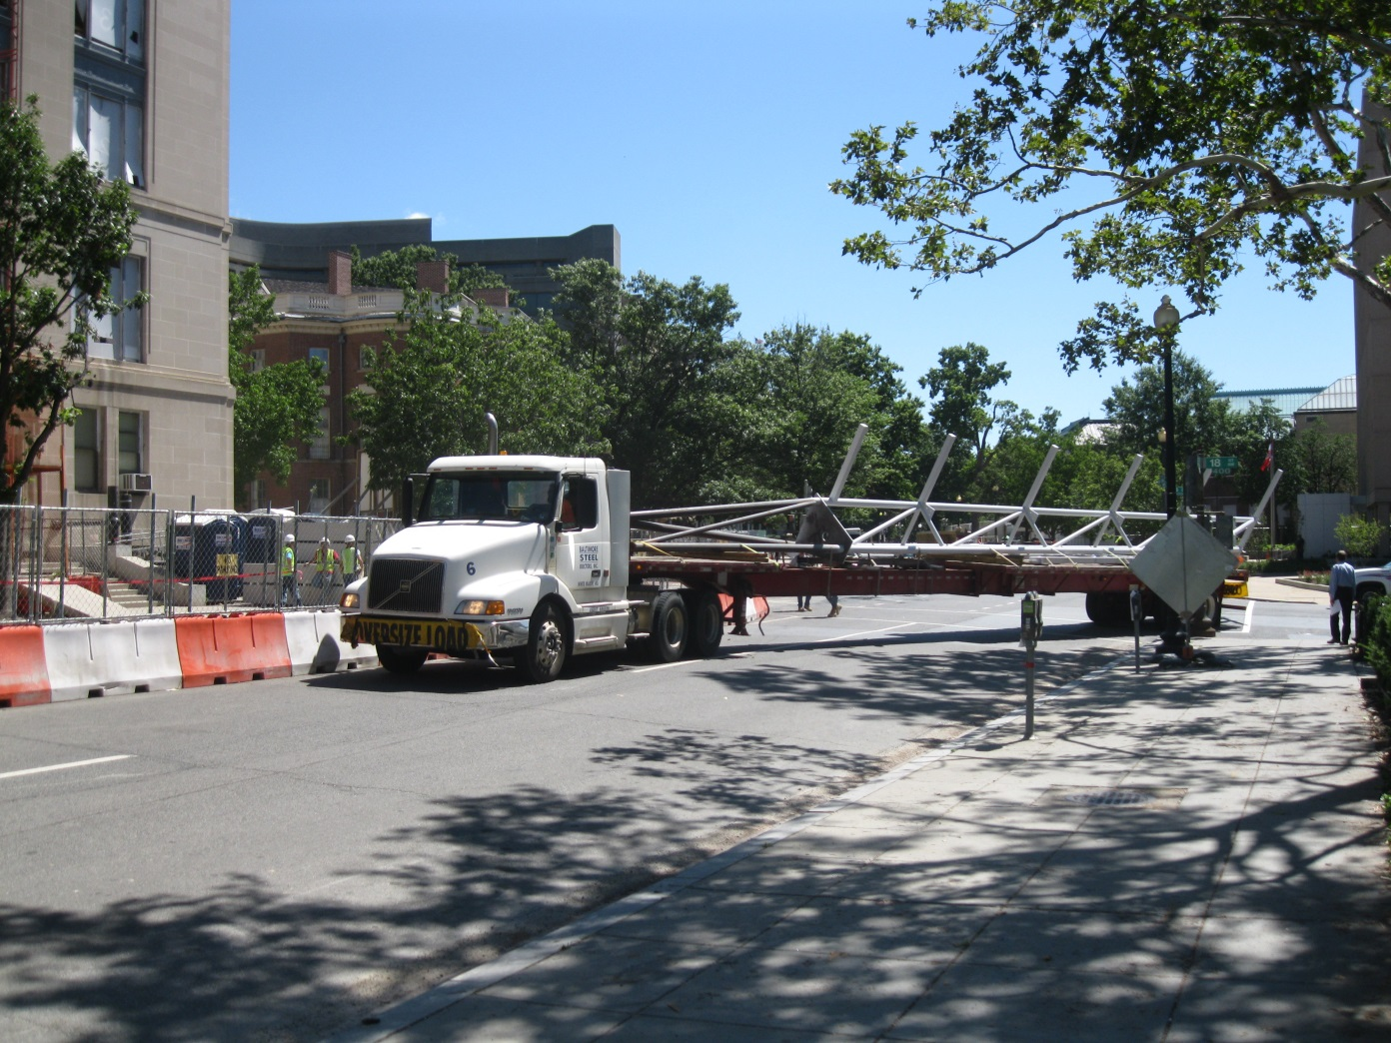
Overview
Analysis 1: New Addition Façade Redesign
U.S. General Services Administration Headquarters Modernization – Phase 1
1800 F St., Washington, D.C.
Ramuel Holgado | Construction Management Option
Project Background
Analysis 1: New Addition Façade Redesign
Analysis 2: New Addition Foundation System
Analysis 3: 3D Laser Scanning Implementation
Analysis 4: Operation and Maintenance of Energy
Conclusion
Acknowledgements
Problem Identification
Delivery of trusses
Site congestion
Cost of smart glass
Contrasts with neoclassical style
Proposed Solution
Downsize the atrium
Use shorter built-up truss columns
Notes:
Problem Identification:
Delivery of 78-foot trusses was difficult in downtown D.C. (shut down intersection for 2 hours a day for over a week straight).
A 90-ton hydraulic truck crane was brought on site solely for the erection of the trusses and located next to the tower crane.
Modern style of the atrium clashes with neoclassical style of the existing building.
Research Goals
Alternate façade
Impact on cost, schedule, and constructability

Slide 6
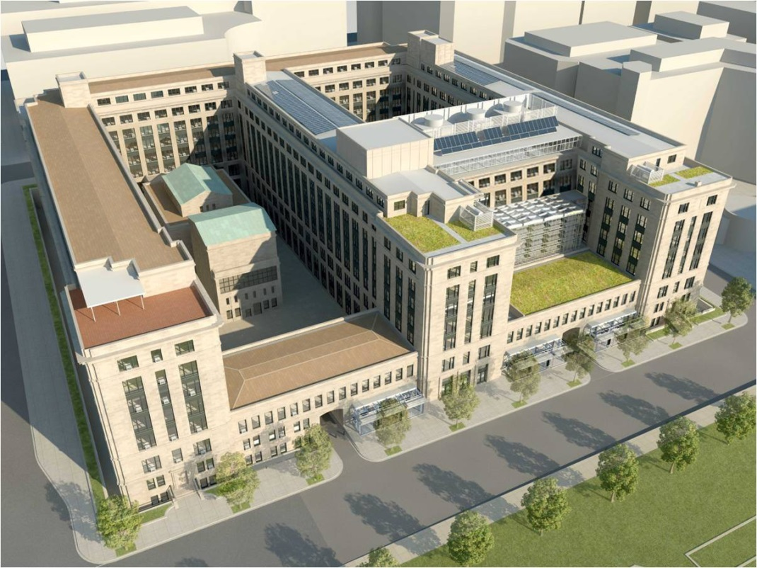
Overview
Analysis 1: New Addition Façade Redesign
U.S. General Services Administration Headquarters Modernization – Phase 1
1800 F St., Washington, D.C.
Ramuel Holgado | Construction Management Option
Project Background
Analysis 1: New Addition Façade Redesign
Analysis 2: New Addition Foundation System
Analysis 3: 3D Laser Scanning Implementation
Analysis 4: Operation and Maintenance of Energy
Conclusion
Acknowledgements
Original Design
78-foot built-up truss columns
Surface area of glazing: 13,175 SF
Alternate Design
51-foot built-up truss columns
Surface area of glazing: 9,000 SF
Walls of 5th and 6th floor constructed similar to existing building façade
Original Design
Alternate Design
Notes:
Alternate Design:
Lower height of atrium by 2 stories.
Limestone on brick masonry backup with 2-½” rigid insulation.
27-foot roof trusses

Slide 7
Overview
Analysis 1: New Addition Façade Redesign
U.S. General Services Administration Headquarters Modernization – Phase 1
1800 F St., Washington, D.C.
Ramuel Holgado | Construction Management Option
Project Background
Analysis 1: New Addition Façade Redesign
Analysis 2: New Addition Foundation System
Analysis 3: 3D Laser Scanning Implementation
Analysis 4: Operation and Maintenance of Energy
Conclusion
Acknowledgements
Cost Comparison
Original Design TOTAL: $8,650,000
Alternate Design TOTAL: $5,793,914.15
SAVINGS: $2,856,085.85
Schedule Comparison
Original Design TOTAL: 67 days
Alternate Design TOTAL: 64 days
ACCELERATION: 3 days
Original Design
Alternate Design
Notes:
Cost analysis completed using unit costs.
Total savings amount to nearly $2.9M.
Schedule accelerated 3 days.

Slide 8
Overview
Analysis 1: New Addition Façade Redesign
U.S. General Services Administration Headquarters Modernization – Phase 1
1800 F St., Washington, D.C.
Ramuel Holgado | Construction Management Option
Project Background
Analysis 1: New Addition Façade Redesign
Analysis 2: New Addition Foundation System
Analysis 3: 3D Laser Scanning Implementation
Analysis 4: Operation and Maintenance of Energy
Conclusion
Acknowledgements
Conclusion
Downsizing the New Addition Façade is not recommended
Eliminates atrium balcony walkways of the 5th and 6th floors of the New Addition
Restricts pedestrian traffic flow
Original Design
Alternate Design
Notes:
Balcony walkways look down on the atrium and towards the National Mall.
Balcony walkways improve pedestrian traffic flow through the building.
Location of the hydraulic truck crane next to the tower crane is the only feasible location.
I completed an acoustical breadth on the atrium, but cannot present it due to time constraints.

Slide 9
Overview
Analysis 1: New Addition Façade Redesign
U.S. General Services Administration Headquarters Modernization – Phase 1
1800 F St., Washington, D.C.
Ramuel Holgado | Construction Management Option
Project Background
Analysis 1: New Addition Façade Redesign
Analysis 2: New Addition Foundation System
Analysis 3: 3D Laser Scanning Implementation
Analysis 4: Operation and Maintenance of Energy
Conclusion
Acknowledgements
Acoustical Breadth
Original Atrium Design (Public Circulation)
NC Rating: 46
RC Rating: 48
Alternate Atrium Design (Public Circulation)
NC Rating: 46
RC Rating: 47
Alternate 5th and 6th Floor Design (Open Plan Areas)
NC Rating: 40
RC Rating: 40
Original Design
Alternate Design

Slide 10
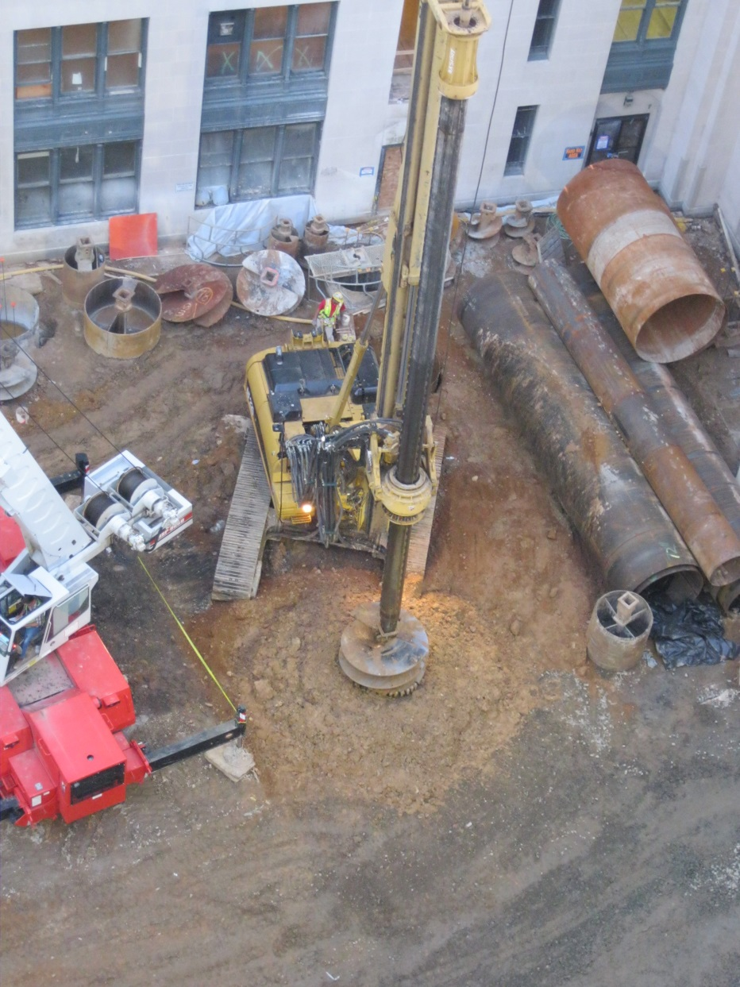
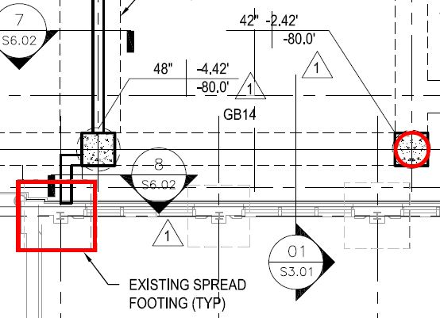
Overview
Analysis 2: New Addition Foundation System
U.S. General Services Administration Headquarters Modernization – Phase 1
1800 F St., Washington, D.C.
Ramuel Holgado | Construction Management Option
Project Background
Analysis 1: New Addition Façade Redesign
Analysis 2: New Addition Foundation System
Analysis 3: 3D Laser Scanning Implementation
Analysis 4: Operation and Maintenance of Energy
Conclusion
Acknowledgements
Problem Identification
New Addition original foundation system: caissons and grade beams
Cost 30% structural system
Long duration
Proposed Solution
Existing building foundation system: spread footings
New Addition alternate foundation system: spread footings
Notes:
Analysis 2 is integrated with my structural breadth.
Research Goals
Alternate foundation system
Impact on cost, schedule, and constructability

Slide 11
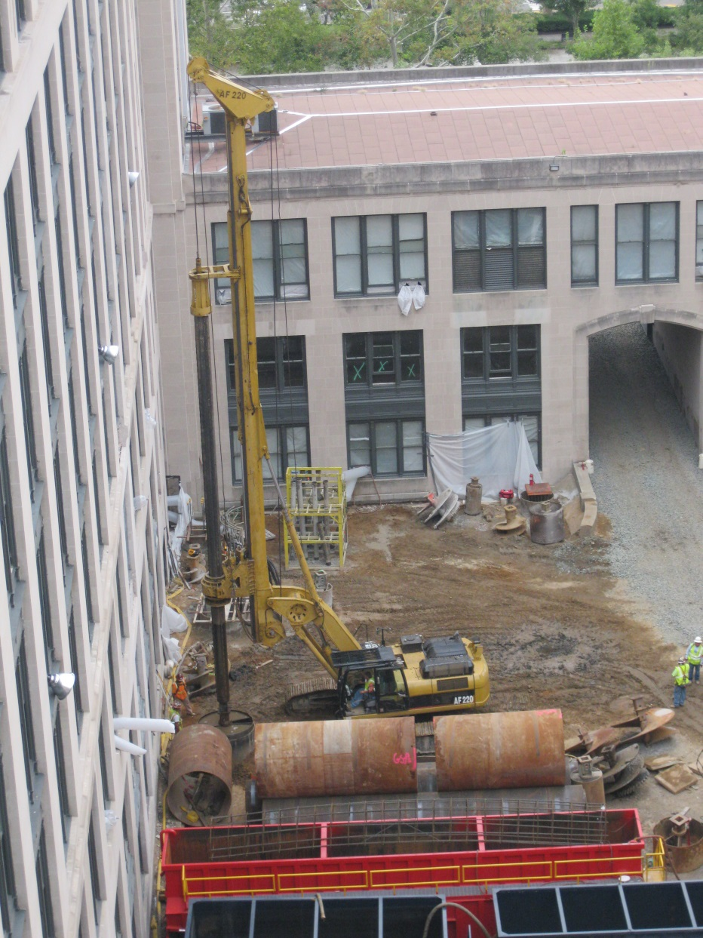
Overview
Analysis 2: New Addition Foundation System
U.S. General Services Administration Headquarters Modernization – Phase 1
1800 F St., Washington, D.C.
Ramuel Holgado | Construction Management Option
Project Background
Analysis 1: New Addition Façade Redesign
Analysis 2: New Addition Foundation System
Analysis 3: 3D Laser Scanning Implementation
Analysis 4: Operation and Maintenance of Energy
Conclusion
Acknowledgements
Geotechnical Report
Natural soils are relatively consistent with the regional geology and include:
Clay
Silty clay
Clayey-sand
Building Loads and Material Properties
Column loads = 285k and 225k
Allowable Soil Bearing Pressure = 5000 psf
Poorly-graded sand
Poorly-graded sand and gravel
Clayey sand and gravel
Notes:
Values provided by the structural engineer.

Slide 12
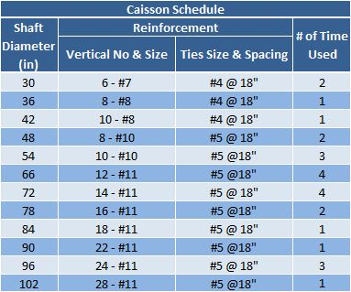
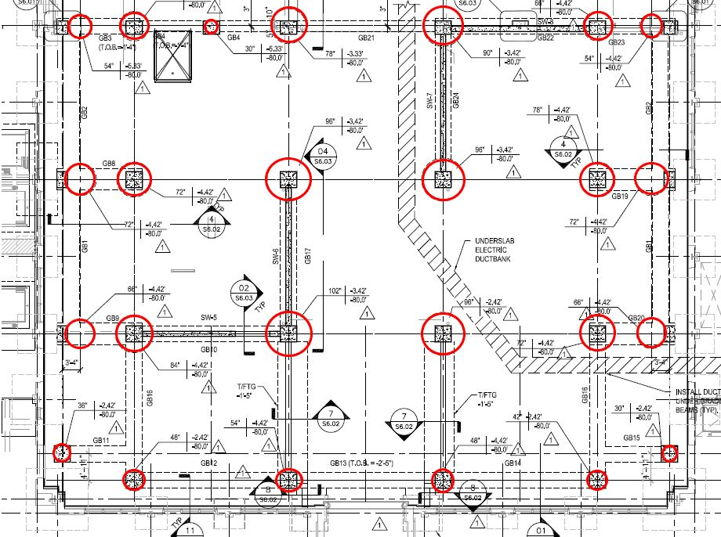
Overview
Analysis 2: New Addition Foundation System
U.S. General Services Administration Headquarters Modernization – Phase 1
1800 F St., Washington, D.C.
Ramuel Holgado | Construction Management Option
Project Background
Analysis 1: New Addition Façade Redesign
Analysis 2: New Addition Foundation System
Analysis 3: 3D Laser Scanning Implementation
Analysis 4: Operation and Maintenance of Energy
Conclusion
Acknowledgements
Existing Building Foundation System
Typical spread footing:
Size: 7’-4” x 7’-4” x 2’-6”
New Addition Original Foundation System
25 caissons
Shaft diameters: 30 inches to 102 inches
Drilled 75 feet to 80 feet deep
24 grade beams

Slide 13
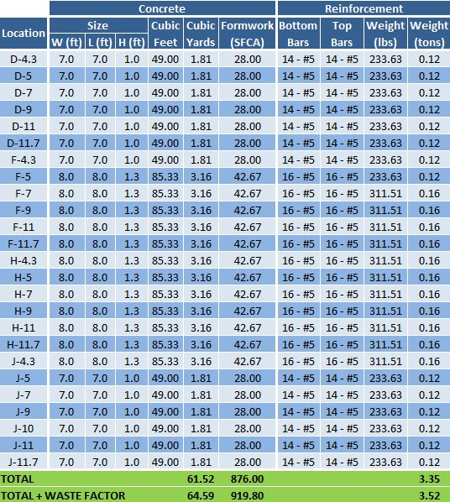
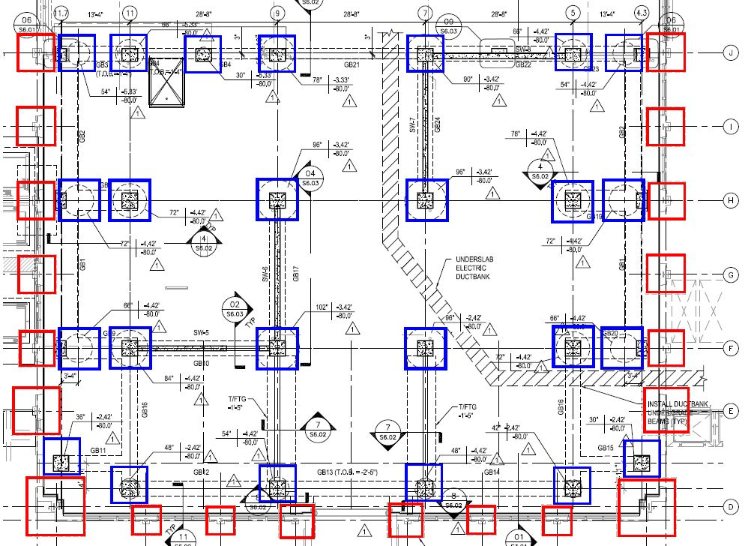
Overview
Analysis 2: New Addition Foundation System
U.S. General Services Administration Headquarters Modernization – Phase 1
1800 F St., Washington, D.C.
Ramuel Holgado | Construction Management Option
Project Background
Analysis 1: New Addition Façade Redesign
Analysis 2: New Addition Foundation System
Analysis 3: 3D Laser Scanning Implementation
Analysis 4: Operation and Maintenance of Energy
Conclusion
Acknowledgements
New Addition Alternate Foundation System
25 total spread footings
12 interior spread footings (P = 285k)
Size: 8’ x 8’ x 1’-4”
13 exterior spread footings (P = 225k)
Size: 7’ x 7’ x 1’
Notes:
25 total spread footings located at caisson locations indicated by blue.
Existing building spread footings are red.
Designed footing sizes using knowledge gained in CE 397A.
Designed spread footings would be located very close to the existing spread footings.

Slide 14
Overview
Analysis 2: New Addition Foundation System
U.S. General Services Administration Headquarters Modernization – Phase 1
1800 F St., Washington, D.C.
Ramuel Holgado | Construction Management Option
Project Background
Analysis 1: New Addition Façade Redesign
Analysis 2: New Addition Foundation System
Analysis 3: 3D Laser Scanning Implementation
Analysis 4: Operation and Maintenance of Energy
Conclusion
Acknowledgements
Cost Comparison
Original Foundation System TOTAL: $1,755,000
Alternate Foundation System TOTAL: $203,857.78
SAVINGS: $1,551,142.22
Schedule Comparison
Original Foundation System TOTAL: 47 days
Alternate Foundation System TOTAL: 12 days
ACCELERATION: 35 days
Notes:
Using spread footings saves over $1.5M and accelerates the schedule 35 days.

Slide 15
Overview
Analysis 2: New Addition Foundation System
U.S. General Services Administration Headquarters Modernization – Phase 1
1800 F St., Washington, D.C.
Ramuel Holgado | Construction Management Option
Project Background
Analysis 1: New Addition Façade Redesign
Analysis 2: New Addition Foundation System
Analysis 3: 3D Laser Scanning Implementation
Analysis 4: Operation and Maintenance of Energy
Conclusion
Acknowledgements
Conclusion
Spread footings as the foundation system for the New Addition is not recommended
Space constraints of East Courtyard
Designed spread footings located up against existing spread footings
Notes:
However, it is not recommended due to the tight space constraints of the East Courtyard.
May be difficult to construct and could potentially damage the existing spread footings.

Slide 16
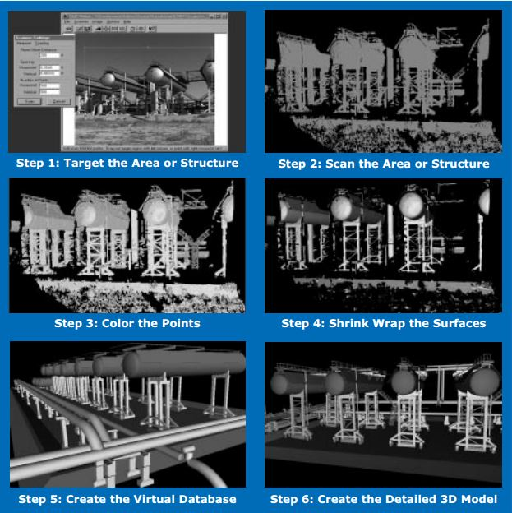
Overview
Analysis 3: 3D Laser Scanning Implementation
U.S. General Services Administration Headquarters Modernization – Phase 1
1800 F St., Washington, D.C.
Ramuel Holgado | Construction Management Option
Project Background
Analysis 1: New Addition Façade Redesign
Analysis 2: New Addition Foundation System
Analysis 3: 3D Laser Scanning Implementation
Analysis 4: Operation and Maintenance of Energy
Conclusion
Acknowledgements
Problem Identification
Outdated as-built drawings
Project did not utilize BIM
Proposed Solution
Leica ScanStation C10
Leica Cyclone
ScanStation C10
3D laser scanner
Full-dome interior scans in minutes
Cyclone
3D point cloud processing software
Web-based sharing and viewing
Notes:
Research Goals
3D laser scanning technology
Improvements in coordination, cost, and schedule

Slide 17
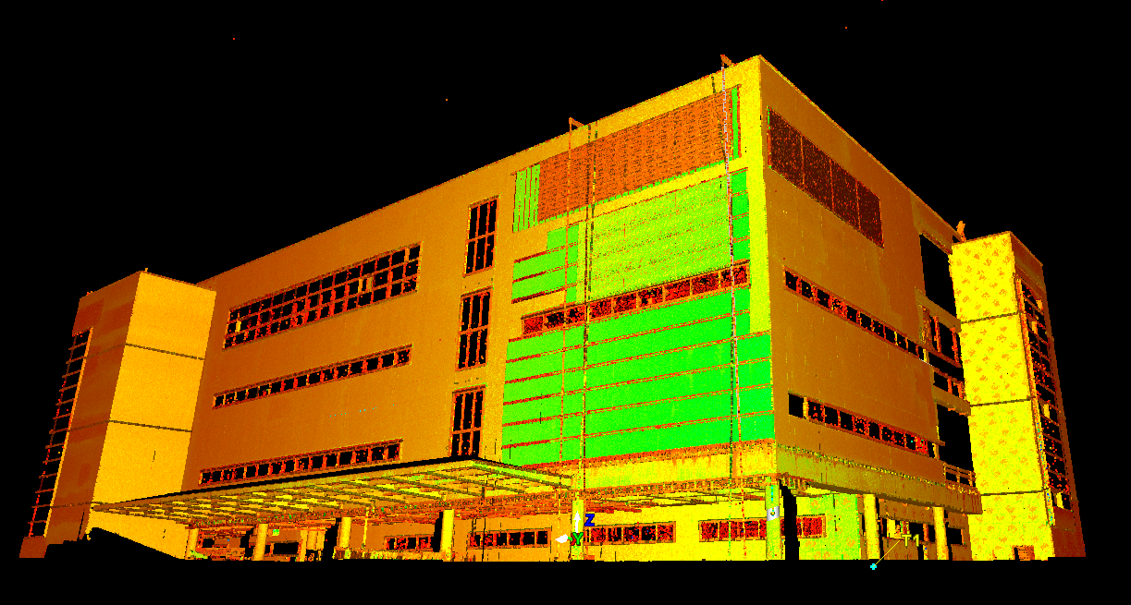
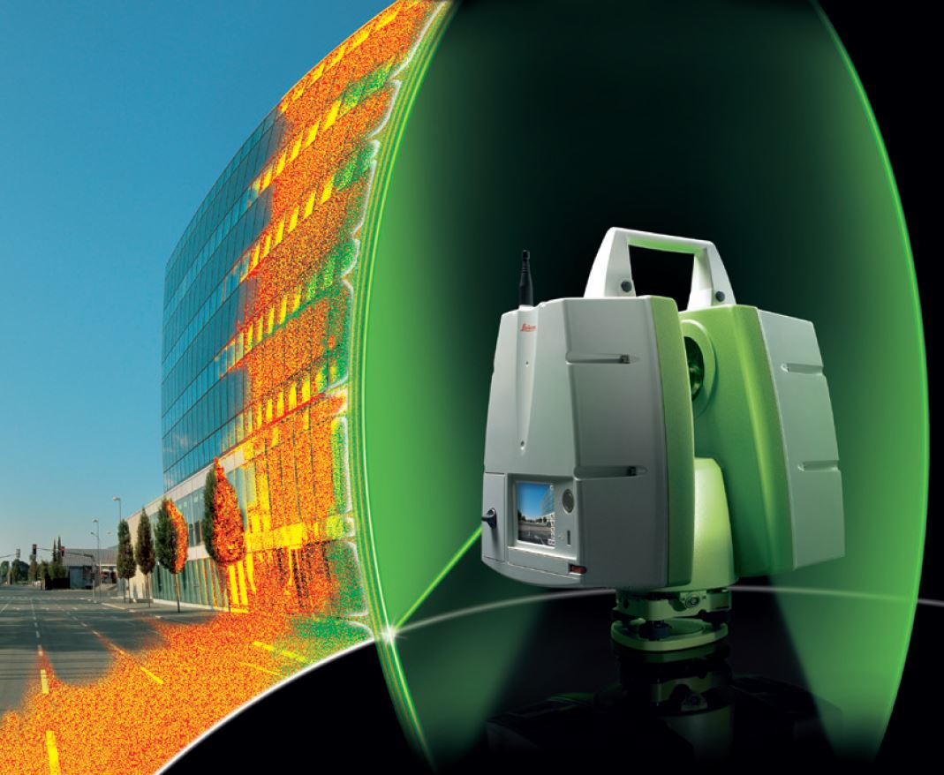
Overview
Analysis 3: 3D Laser Scanning Implementation
U.S. General Services Administration Headquarters Modernization – Phase 1
1800 F St., Washington, D.C.
Ramuel Holgado | Construction Management Option
Project Background
Analysis 1: New Addition Façade Redesign
Analysis 2: New Addition Foundation System
Analysis 3: 3D Laser Scanning Implementation
Analysis 4: Operation and Maintenance of Energy
Conclusion
Acknowledgements
Creation of As-Built Drawings
2D as-built drawings
Plans, elevations, sections, and details
3D models of existing conditions
Improved Coordination and Design
Simultaneous access of 3D point cloud data sets and models from anywhere
Clash detection
Quality Control Verification On Site
Slab levelness, truss column plumbness, installation locations, etc.
Quality control will be maintained throughout the project
Notes:
Creation of As-Built Drawings
Drawings and models can be imported into CAD
Improved Coordination and Design
Web-based sharing and viewing allow for simultaneous access
Clash detection between 3D model and planned designs using Navisworks

Slide 18
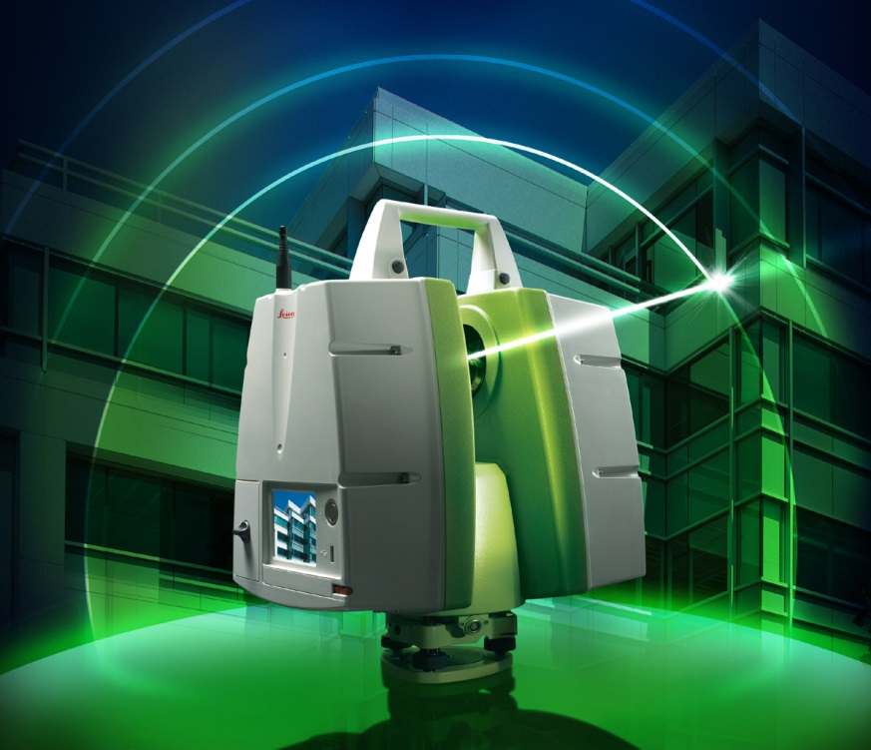
Overview
Analysis 3: 3D Laser Scanning Implementation
U.S. General Services Administration Headquarters Modernization – Phase 1
1800 F St., Washington, D.C.
Ramuel Holgado | Construction Management Option
Project Background
Analysis 1: New Addition Façade Redesign
Analysis 2: New Addition Foundation System
Analysis 3: 3D Laser Scanning Implementation
Analysis 4: Operation and Maintenance of Energy
Conclusion
Acknowledgements
Cost of Implementation
Initial cost of equipment: $150,000
Cost of maintenance: $52,000
Cost of labor for scanning and processing: $15,200
TOTAL: $217,200
Cost of Change Orders
Estimated Cost: Up to $424,892
Change orders potential impacted:
New Addition Curtain Wall
Wing 2 Trench Infill
Sixth Floor Wing 2 Rebuild Columns
Additional Ceiling Height Change on Third and Fourth Floors of Wing 2
Additional Concrete Demolition at the East Courtyard
Window Sill Repairs
Schedule Summary
Scan 9 total floors at approximately 48,000 SF each: 9 days
Process the data to create a model: 10 days
TOTAL: 19 days
Notes:
Total cost of implementation including initial cost, maintenance, and labor = $217,200
Cost of change order may total up to $424,892
Schedule impact is only 19 days for scanning and processing of a model

Slide 19
Overview
Analysis 3: 3D Laser Scanning Implementation
U.S. General Services Administration Headquarters Modernization – Phase 1
1800 F St., Washington, D.C.
Ramuel Holgado | Construction Management Option
Project Background
Analysis 1: New Addition Façade Redesign
Analysis 2: New Addition Foundation System
Analysis 3: 3D Laser Scanning Implementation
Analysis 4: Operation and Maintenance of Energy
Conclusion
Acknowledgements
Conclusion
3D Laser Scanning is recommended
GSA should purchase and maintain equipment instead of renting the process
Notes:
GSA should purchase and maintain equipment instead of renting the process. Since they’re a big organization, they can use it on other projects.

Slide 20
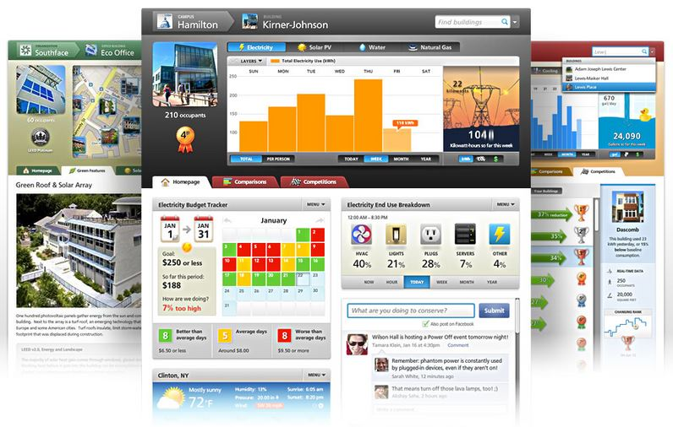
Overview
Analysis 4: Operation and Maintenance of Energy
U.S. General Services Administration Headquarters Modernization – Phase 1
1800 F St., Washington, D.C.
Ramuel Holgado | Construction Management Option
Project Background
Analysis 1: New Addition Façade Redesign
Analysis 2: New Addition Foundation System
Analysis 3: 3D Laser Scanning Implementation
Analysis 4: Operation and Maintenance of Energy
Conclusion
Acknowledgements
Problem Identification
Buildings becoming more complex to operate
Occupants have no way of getting feedback on their energy usage
Proposed Solution
Building Dashboard by Lucid Design Group
Operational phase
“Building Dashboard has been designed to be the most technically capable and visually spectacular data monitoring and display system available for commercial and institutional facilities.”
-Lucid Design Group
Notes:
Advanced MEP systems and green building features make the operation and maintenance of energy a critical issue to research
Research Goals
Benefits of energy management software
Savings in resource consumption

Slide 21
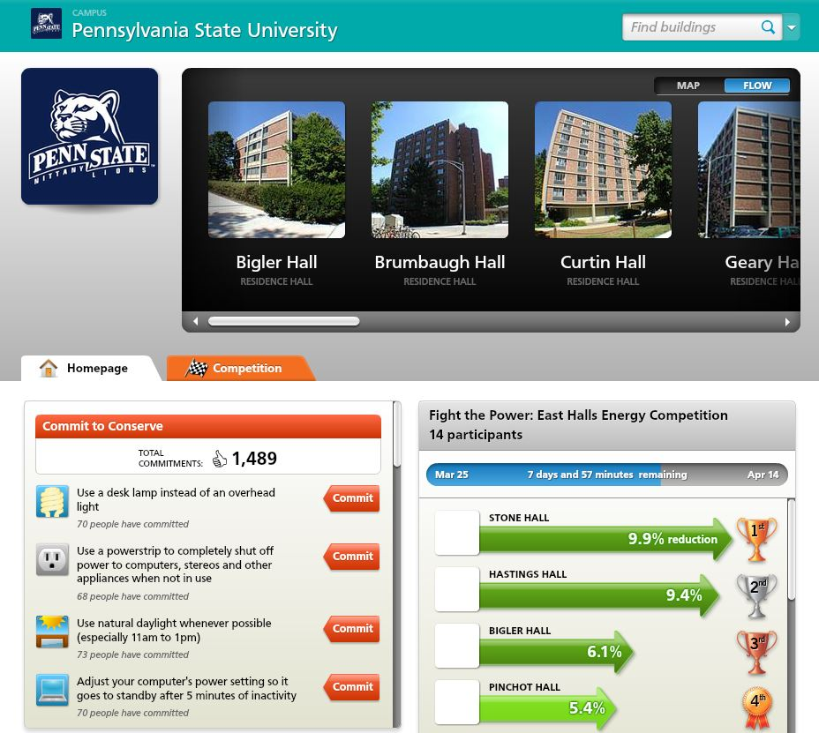
Overview
Analysis 4: Operation and Maintenance of Energy
U.S. General Services Administration Headquarters Modernization – Phase 1
1800 F St., Washington, D.C.
Ramuel Holgado | Construction Management Option
Project Background
Analysis 1: New Addition Façade Redesign
Analysis 2: New Addition Foundation System
Analysis 3: 3D Laser Scanning Implementation
Analysis 4: Operation and Maintenance of Energy
Conclusion
Acknowledgements
Building Dashboard
Connects to virtually all building automation and energy management systems
Connects to all utility meters and submeters
Monitors all resources consumed within a building including:
Building Dashboard Network
A social network for building occupants
Implemented on East Halls at the Pennsylvania State University
Electricity
Water
Natural gas
Heating
Cooling
Solar electricity
Wind electricity
Solar thermal energy
Geothermal energy
Rainwater collection and recycling
Wastewater recycling
Notes:
Building Dashboard Network
A social network for building occupants that lets users view, compare, and share their consumption info.

Slide 22
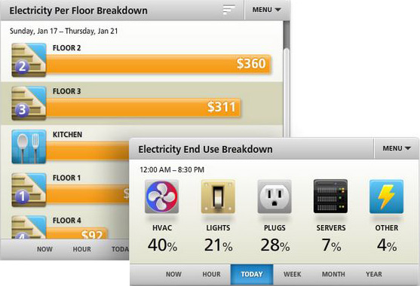
Overview
Analysis 4: Operation and Maintenance of Energy
U.S. General Services Administration Headquarters Modernization – Phase 1
1800 F St., Washington, D.C.
Ramuel Holgado | Construction Management Option
Project Background
Analysis 1: New Addition Façade Redesign
Analysis 2: New Addition Foundation System
Analysis 3: 3D Laser Scanning Implementation
Analysis 4: Operation and Maintenance of Energy
Conclusion
Acknowledgements
Track and Monitor Resource Consumption
Fully automated data collection, processing, and storage
Resource consumption
Breakdown by wing, floor, room, and end use
Real-Time Competitions
Competitions may be held between individual floors, buildings, and entire organizations
Studies have shown that competitions can facilitate reductions as high as 56%
Notes:
Track and Monitor Resource Consumption
GSA employees can determine their resource consumption

Slide 23
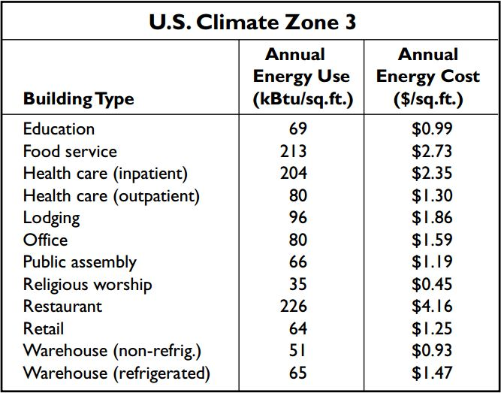
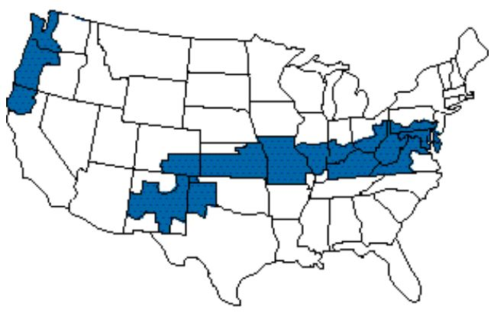
Overview
Analysis 4: Operation and Maintenance of Energy
U.S. General Services Administration Headquarters Modernization – Phase 1
1800 F St., Washington, D.C.
Ramuel Holgado | Construction Management Option
Project Background
Analysis 1: New Addition Façade Redesign
Analysis 2: New Addition Foundation System
Analysis 3: 3D Laser Scanning Implementation
Analysis 4: Operation and Maintenance of Energy
Conclusion
Acknowledgements
Energy Consumption
Annual Energy Rate: $1.59/SF
Phase 1 SF: 429,000 SF
Annual Energy Cost: $682,110
Potential Savings
30.4% reduction (Google NYC Office)
Estimated Annual Energy Cost: $474,748.56
Estimated Annual Savings: $207,361.44
Cost of Implementation
Lucid Design Group was unable to provide a quote for the implementation of Building Dashboard onto the GSA Headquarters
Notes:
Using the rates provided in the chart, the annual energy cost for the GSA Headquarters is $682,110
With Building Dashboard, estimated annual savings total over $200,000
However, I was unable to receive a quote for the implementation of Building Dashboard.

Slide 24
Overview
Analysis 4: Operation and Maintenance of Energy
U.S. General Services Administration Headquarters Modernization – Phase 1
1800 F St., Washington, D.C.
Ramuel Holgado | Construction Management Option
Project Background
Analysis 1: New Addition Façade Redesign
Analysis 2: New Addition Foundation System
Analysis 3: 3D Laser Scanning Implementation
Analysis 4: Operation and Maintenance of Energy
Conclusion
Acknowledgements
Conclusion
Implementation of Building Dashboard is not recommended at this time
Relies solely on occupant behavior
Only as good as the engagement programs that integrate it
More long-term studies need to be conducted
Cost of implementation is unknown at this time
Notes:
Therefore, I cannot recommend the implementation of Building Dashboard at this time.
People like it at first, but the systems tend to fade into the background without offering a compelling reason to use them.

Slide 25
Overview
Conclusions
U.S. General Services Administration Headquarters Modernization – Phase 1
1800 F St., Washington, D.C.
Ramuel Holgado | Construction Management Option
Project Background
Analysis 1: New Addition Façade Redesign
Analysis 2: New Addition Foundation System
Analysis 3: 3D Laser Scanning Implementation
Analysis 4: Operation and Maintenance of Energy
Conclusion
Acknowledgements
Analysis 1: New Addition Façade Redesign
Downsizing the New Addition Façade is not recommended
Eliminates atrium balcony walkways of the 5th and 6th floors of the New Addition
Restricts pedestrian traffic flow
Analysis 2: New Addition Foundation System
Spread footings as the foundation system for the New Addition is not recommended
Space constraints of East Courtyard
Designed spread footings located up against existing spread footings
Analysis 3: 3D Laser Scanning Implementation
3D Laser Scanning is recommended
GSA should purchase and maintain equipment instead of renting the process
Analysis 4: Operation and Maintenance of Energy
Implementation of Building Dashboard is not recommended at this time
Relies solely on occupant behavior
Only as good as the engagement programs that integrate it
More long-term studies need to be conducted
Cost of implementation is unknown at this time

Slide 26
Overview
Acknowledgements
U.S. General Services Administration Headquarters Modernization – Phase 1
1800 F St., Washington, D.C.
Ramuel Holgado | Construction Management Option
Project Background
Analysis 1: New Addition Façade Redesign
Analysis 2: New Addition Foundation System
Analysis 3: 3D Laser Scanning Implementation
Analysis 4: Operation and Maintenance of Energy
Conclusion
Acknowledgements
Academic Acknowledgements
The Pennsylvania State University AE Faculty
Dr. Chimay Anumba
Industry Acknowledgements
Special Thanks
J.R. Russell – Walsh Construction Project Manager
Petar Radakovic – Walsh Construction Project Engineer
Dean Smith – GSA Project Executive
Justin Purcell – Heery International Project Engineer
PACE Industry Members
Family and Friends
Notes:
I’d like to thank the Penn State AE faculty, especially Dr. Anumba, the Whiting-Turner/Walsh Group Joint Venture, especially J.R. Russell who is the project manager, and the GSA.

Slide 27
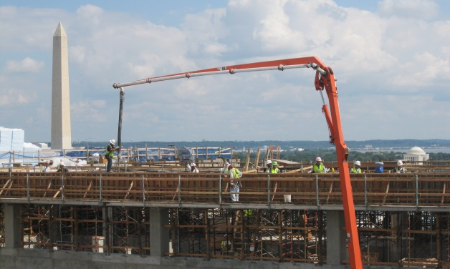
Questions
U.S. General Services Administration Headquarters Modernization – Phase 1
1800 F St., Washington, D.C.
Ramuel Holgado | Construction Management Option
References
“Are You Scanning?” IMAGINiT Civil Solutions Blog. 2012. Web. 6 April 2013. <http://blogs.rand.com/civil/2012/09/are-you-scanning.html>
“Facebook Sued Over the ‘Like’ Button.” Technorati. 2013. Web. 6 April 2013.
<http://technorati.com/social-media/article/facebook-sued-over-the-like- button/>
“Leica Cyclone.” Leica Geosystems. 2013. Web. 20 March 2013.
<http://hds.leica-geosystems.com/en/Leica-Cyclone_6515.htm>
“Leica ScanStation C10.” Leica Geosystems. 2013. Web. 20 March 2013.
<http://www.leica-geosystems.us/en/Leica-ScanStation-C10_79411.htm>
“Leica TruView & Cyclone PUBLISHER.” Leica Geosystems. 2013. Web. 20 March 2013. <http://hds.leica-geosystems.com/en/Leica-TruView-Cyclone- PUBLISHER_64524.htm>
References
“Lucid Building Dashboard.” Lucid Design Group. 2013. Web. 27 March 2013.
< http://www.luciddesigngroup.com >
“Average Energy Use and Costs Throughout the United States.” SECO. Web. 6 April 2013. <http://www.seco.cpa.state.tx.us/TEP_Production/c/EPAEnergyStarSmall BusinessGuide.pdf>
“Virtual Reality & Laser Scanning Applications.” CTRE. 2002. Web. 6 April 2013.
<http://www.ctre.iastate.edu/pubs/vrls.pdf>

Slide 29
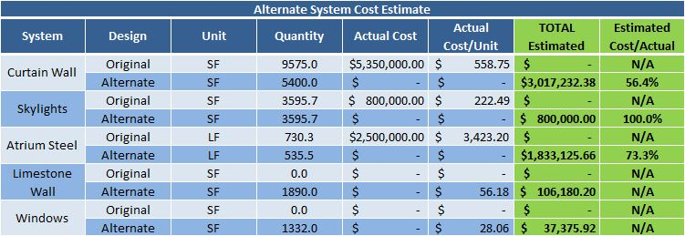
Appendices – New Addition Façade Redesign
U.S. General Services Administration Headquarters Modernization – Phase 1
1800 F St., Washington, D.C.
Ramuel Holgado | Construction Management Option

Slide 30
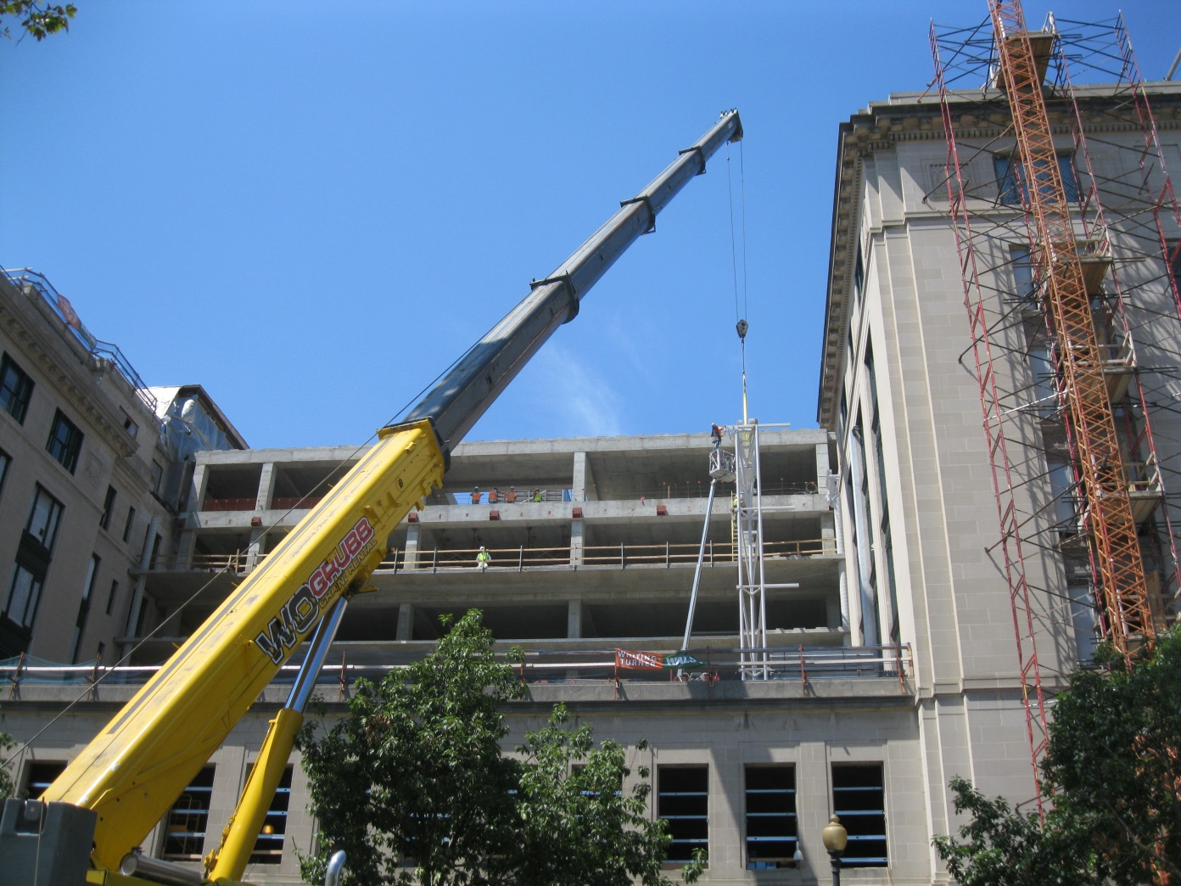
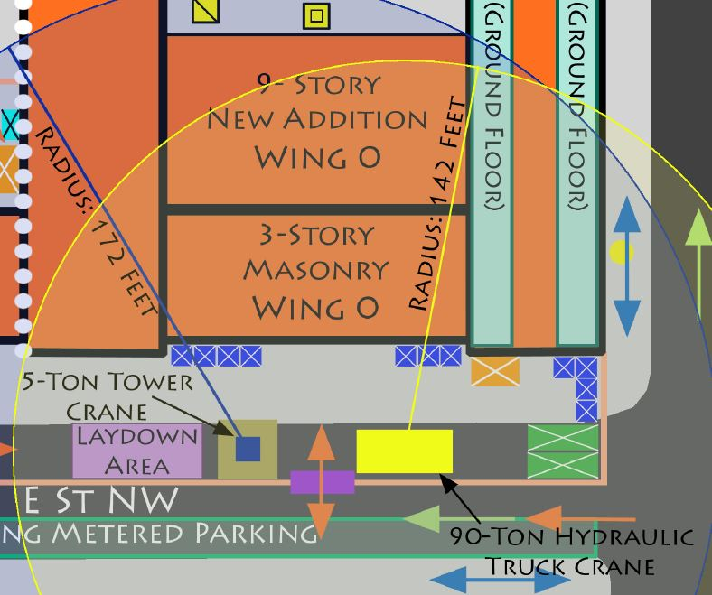
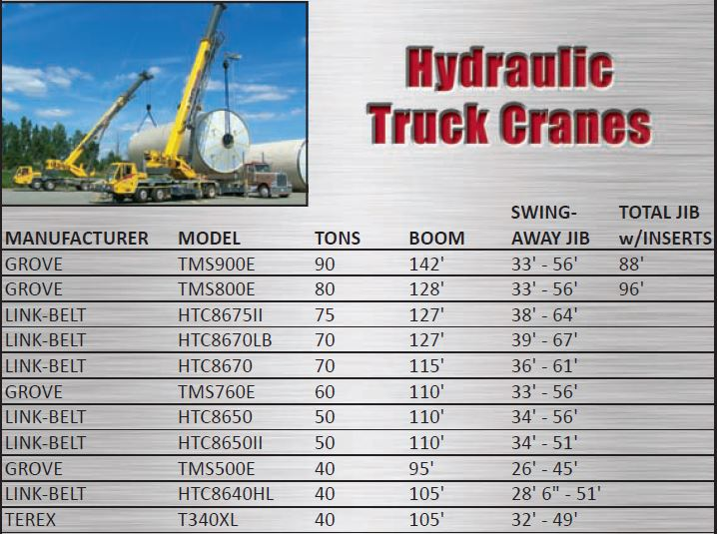
Appendices – Crane
U.S. General Services Administration Headquarters Modernization – Phase 1
1800 F St., Washington, D.C.
Ramuel Holgado | Construction Management Option
Built-Up Truss Columns

Slide 31
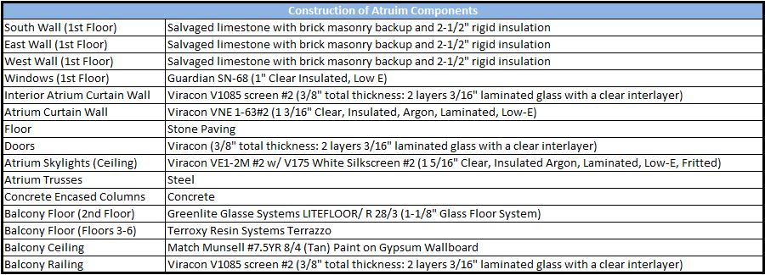
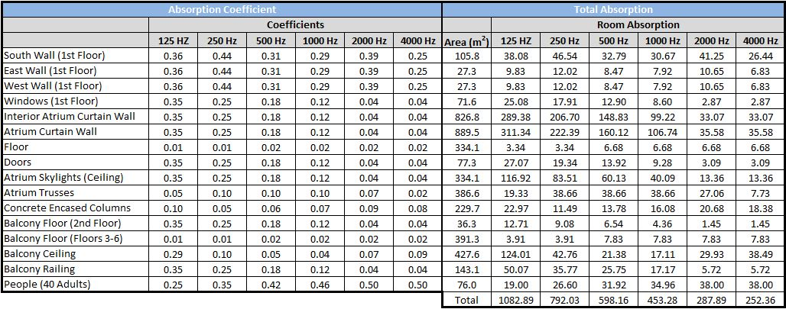
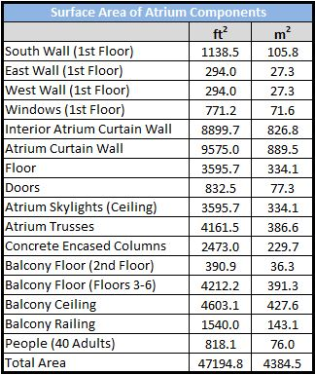
Original Design - Atrium
Appendices – Acoustical Breadth
U.S. General Services Administration Headquarters Modernization – Phase 1
1800 F St., Washington, D.C.
Ramuel Holgado | Construction Management Option

Slide 32
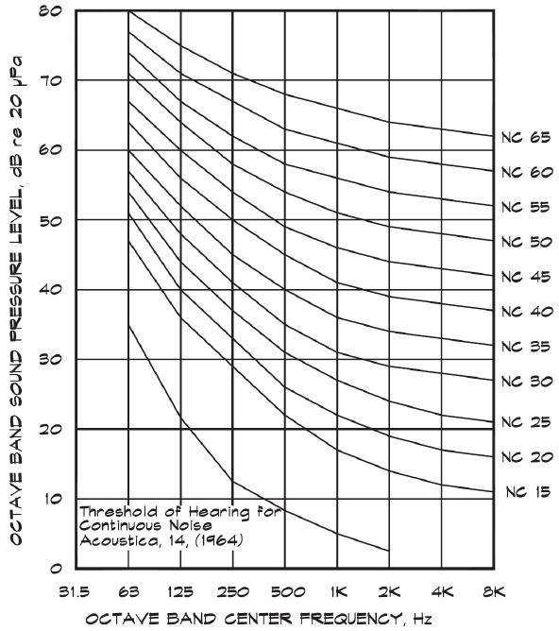
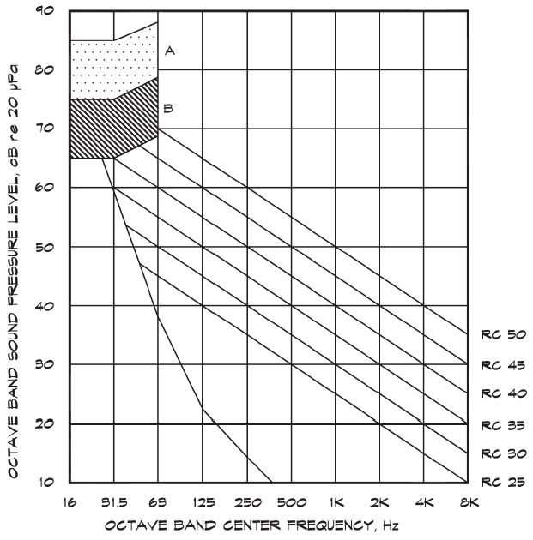
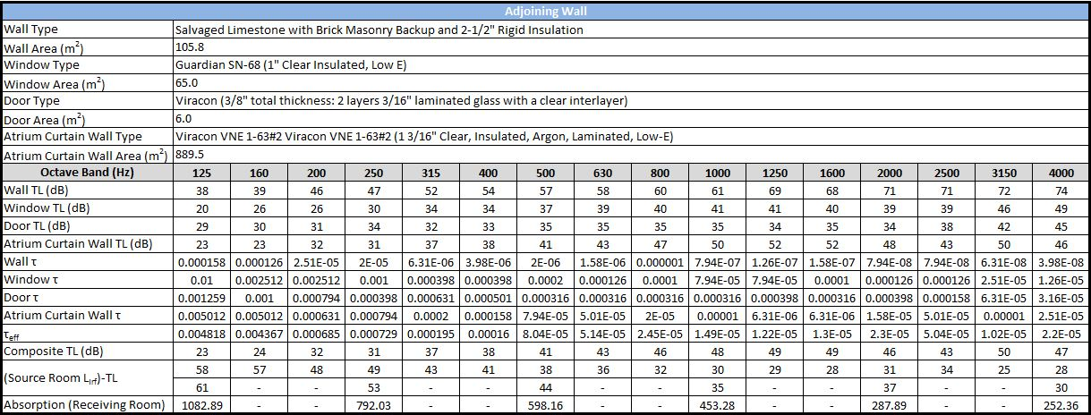
Original Design - Atrium
Appendices – Acoustical Breadth
U.S. General Services Administration Headquarters Modernization – Phase 1
1800 F St., Washington, D.C.
Ramuel Holgado | Construction Management Option

Slide 33
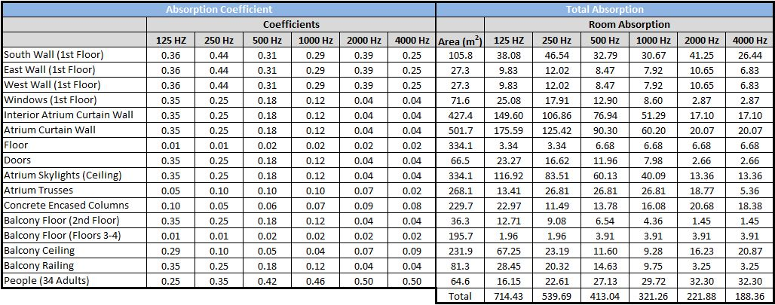
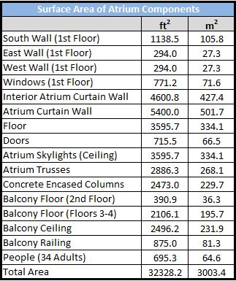
Alternate Design - Atrium
Appendices – Acoustical Breadth
U.S. General Services Administration Headquarters Modernization – Phase 1
1800 F St., Washington, D.C.
Ramuel Holgado | Construction Management Option

Slide 34
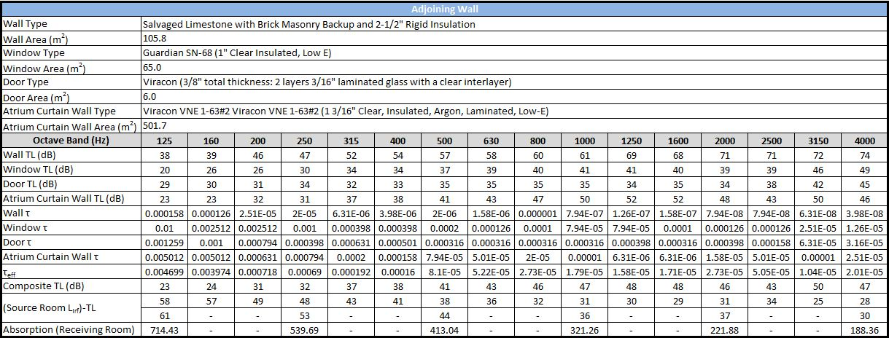
Alternate Design - Atrium
Appendices – Acoustical Breadth
U.S. General Services Administration Headquarters Modernization – Phase 1
1800 F St., Washington, D.C.
Ramuel Holgado | Construction Management Option

Slide 35
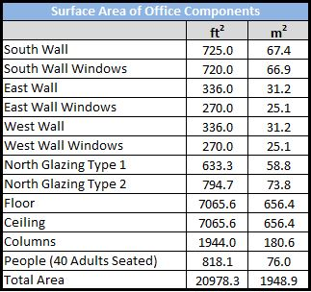
Alternate Design - Office
Appendices – Acoustical Breadth
U.S. General Services Administration Headquarters Modernization – Phase 1
1800 F St., Washington, D.C.
Ramuel Holgado | Construction Management Option

Slide 36
Alternate Design - Office
Appendices – Acoustical Breadth
U.S. General Services Administration Headquarters Modernization – Phase 1
1800 F St., Washington, D.C.
Ramuel Holgado | Construction Management Option

Slide 37
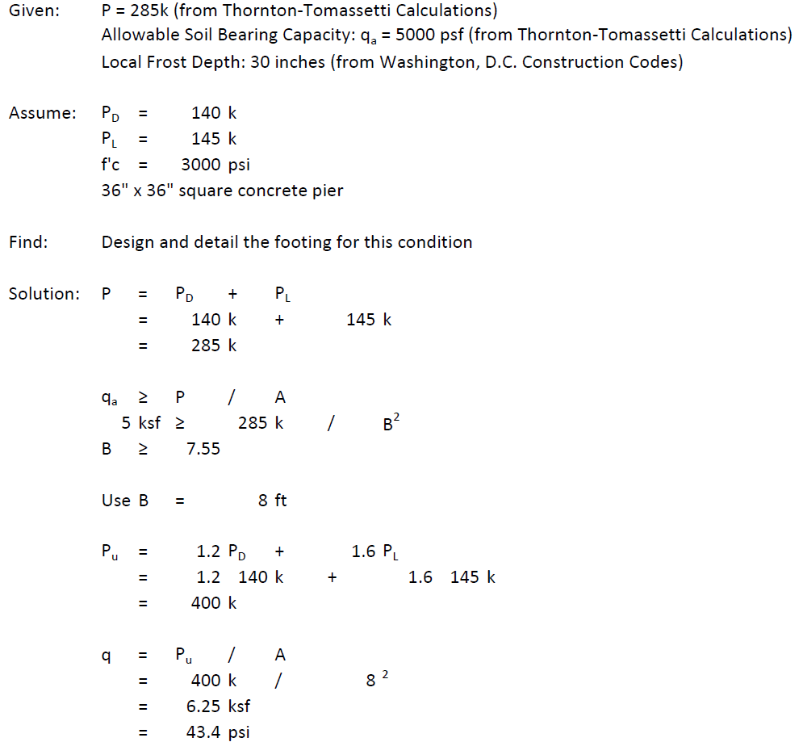
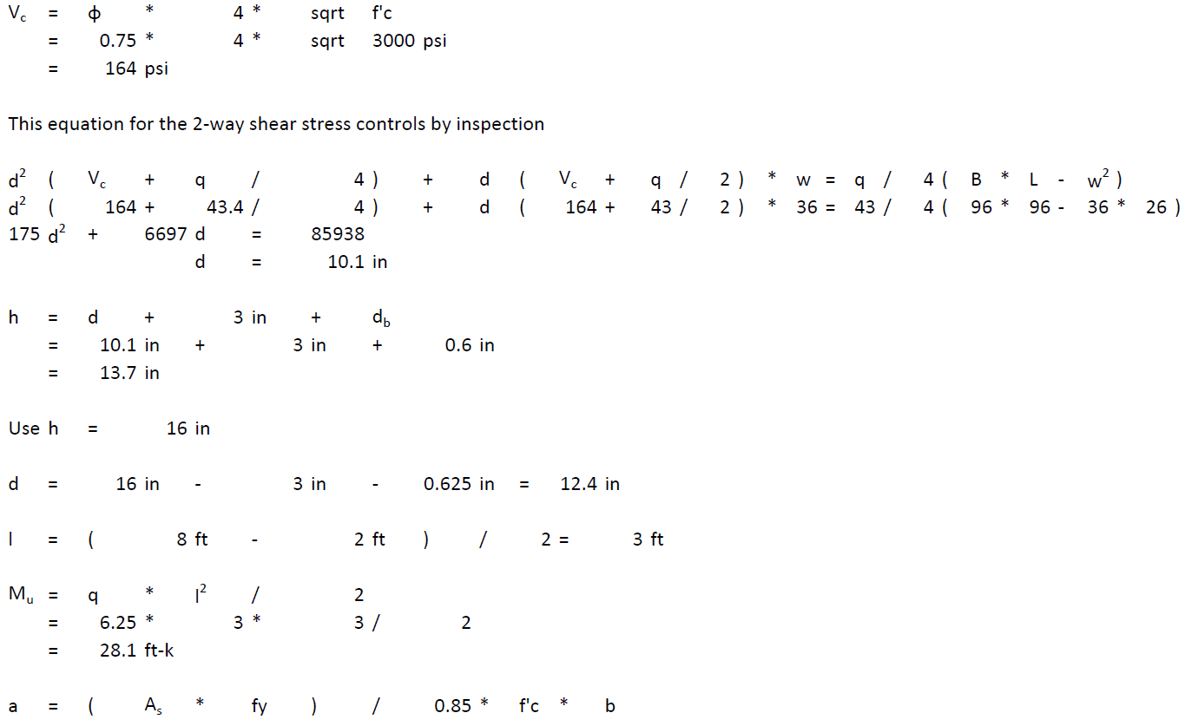
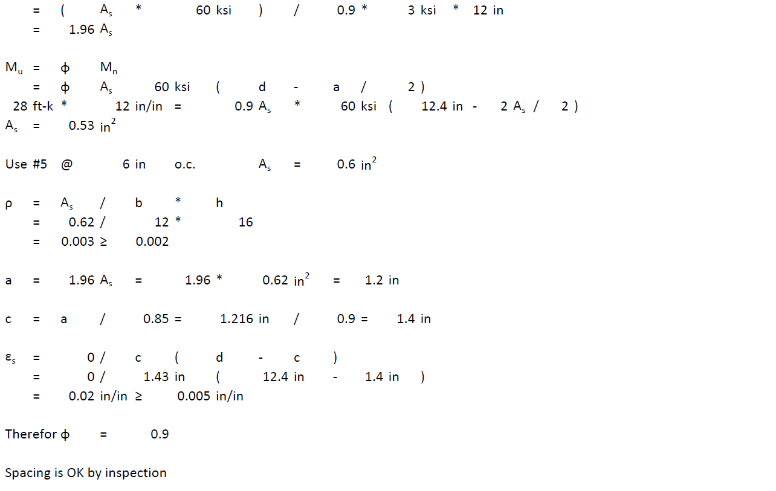
Appendices – New Addition Foundation System
U.S. General Services Administration Headquarters Modernization – Phase 1
1800 F St., Washington, D.C.
Ramuel Holgado | Construction Management Option

Slide 38
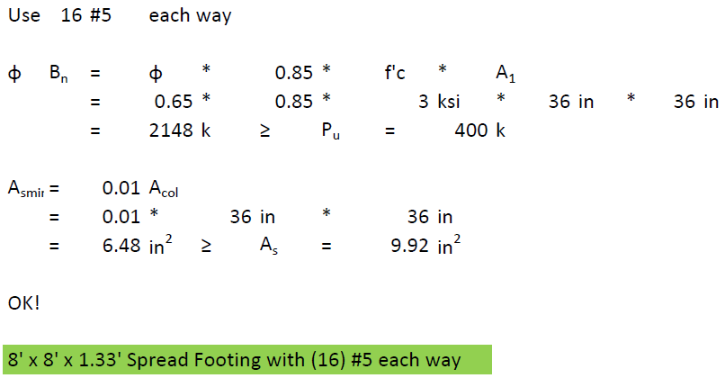
Appendices – New Addition Foundation System
U.S. General Services Administration Headquarters Modernization – Phase 1
1800 F St., Washington, D.C.
Ramuel Holgado | Construction Management Option

Slide 39
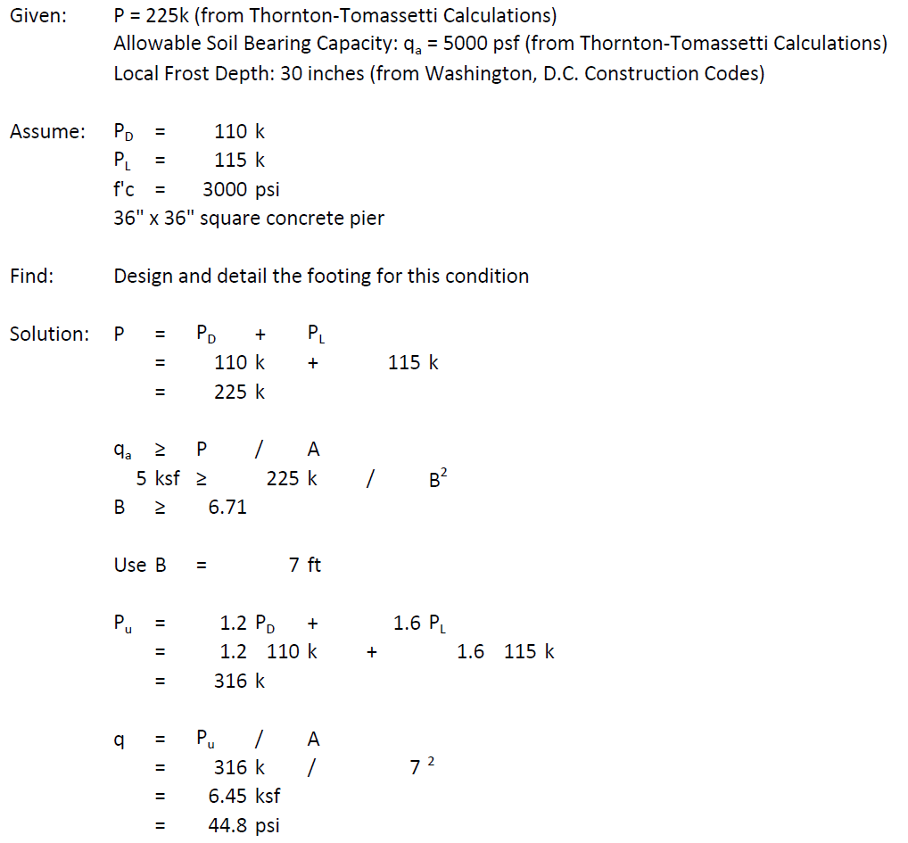
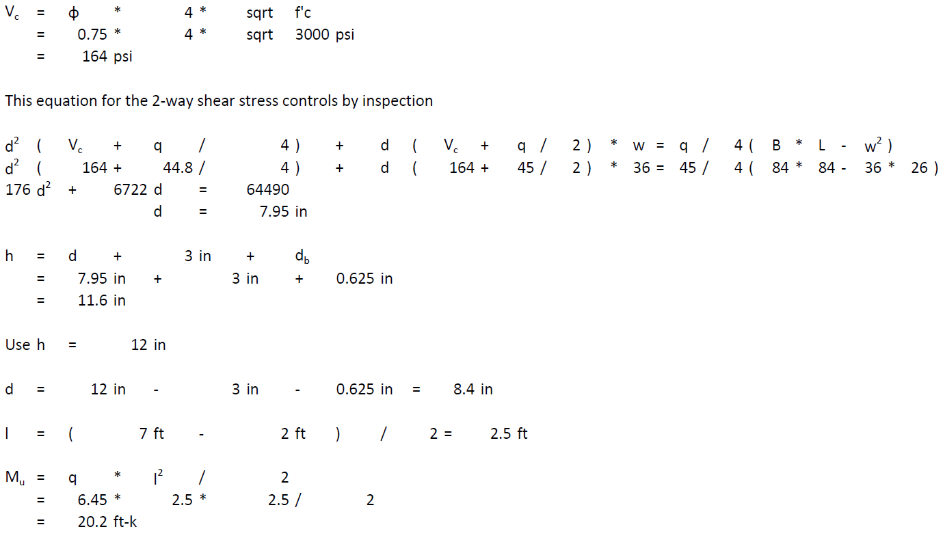
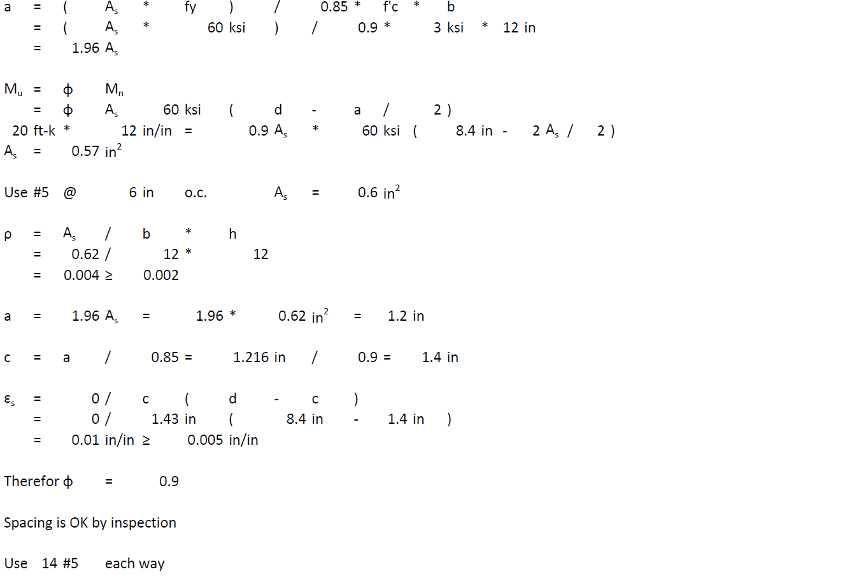
Appendices – New Addition Foundation System
U.S. General Services Administration Headquarters Modernization – Phase 1
1800 F St., Washington, D.C.
Ramuel Holgado | Construction Management Option

Slide 40
Appendices – New Addition Foundation System
U.S. General Services Administration Headquarters Modernization – Phase 1
1800 F St., Washington, D.C.
Ramuel Holgado | Construction Management Option

Slide 41
Appendices – New Addition Foundation System
U.S. General Services Administration Headquarters Modernization – Phase 1
1800 F St., Washington, D.C.
Ramuel Holgado | Construction Management Option

Slide 42
Appendices – Change Orders
U.S. General Services Administration Headquarters Modernization – Phase 1
1800 F St., Washington, D.C.
Ramuel Holgado | Construction Management Option
New Addition Curtain Wall
Notch the belt courses that protruded into the curtain wall resulting in a 15 day delay
Dimensional shop drawing bust resulted in an expansion joint that is 2inches instead of the designed 4 inches
Structural engineer is currently verifying if this reduction is acceptable
Wing 2 Trench Infill
Dimensional inconsistencies
Infill trench with leveling compound or concrete
Sixth Floor Wing 2 Rebuild Columns
25 columns on the sixth floor of Wing 2 needed rebuilding to accommodate the furniture dimensions of the tenant fit-out drawings
Cost of change order: $24,905
Additional Ceiling Height Change on Third and Fourth Floors of Wing 2
Ceiling heights were changed from 8’-8” to 9’-0”
Previously installed bulkheads were adjusted accordingly
Cost of change order: $22,787
Additional Concrete Demolition at the East Courtyard
Concrete at the East Courtyard was demolished and disposed
Exact quantity initially unknown
Window Sill Repairs
Conducted window sill survey of the east and west facing windows of the sixth floor of Wing 2
All frames were found to have a combination of cracks, gouges, fiber separation, and decay
All 3,650 window frames and sills were restored
Cost of change order: $377,200

Slide 43
Appendices – Building Dashboard
U.S. General Services Administration Headquarters Modernization – Phase 1
1800 F St., Washington, D.C.
Ramuel Holgado | Construction Management Option
Building Dashboard Orbs
Displays building resource consumption levels in real-time
Consumption levels may be set to entire building or individual floors

